Slide 1

Women in Politics and Political Violence Against Women
PRESENTED BY Nu Wai Thet (mmdt2024.001) and Khine Zar Lwin mmdt2024.037, Mentor Nuam Man Cing

Slide 2

Content
Goal & Problem Statement
Analysis of PVTW Events
Hypothesis Testing
Statistical Approach & Model Selection
Key Findings & Insights
Conclusion

Slide 3
Goal and Problem Statement
Hypothesis Goal: The aim of this study is to examine whether the number of women in parliament is significantly correlated with the frequency or intensity of attacks targeting political figures. Specifically, we seek to investigate whether an increase or decrease in women’s representation in parliament influences the occurrence of violent attacks on women in political roles.
Null Hypothesis: The number of women in parliament has no correlation with the number of attacks.
Alternative Hypothesis: A significant relationship exists where an increase or decrease in the number of women in parliament leads to more attacks.

Slide 4
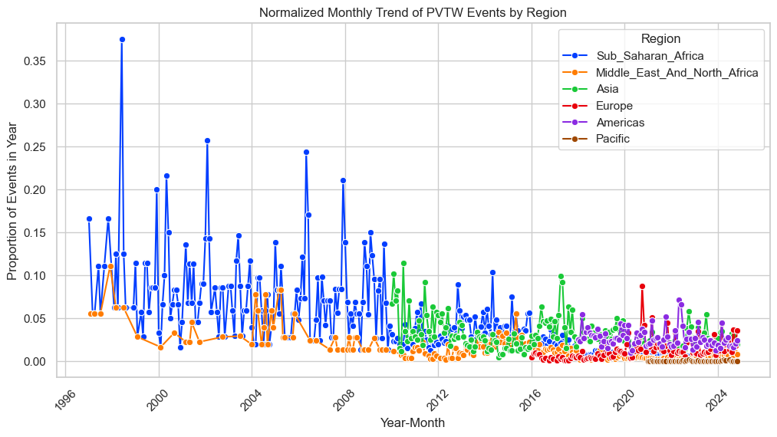
How do the proportions of PVTW events vary across different regions over time, and are there any notable spikes or trends in specific regions?
The graph shows the distribution of PVTW (Political Violence Targeting Women) events across different time periods and regions.
Some regions experience consistently high levels of violence, while others show periodic spikes.
💡 Key Insights:
Trends Over Time: Peaks in PVTW events correspond to major political shifts or election cycles, indicating that women face heightened risks during political transitions.
Regional Differences:
Sub-Saharan Africa and the Middle East & North Africa exhibit the highest number of PVTW events, likely due to ongoing conflicts and political instability.
Europe and the Americas have relatively lower but still significant cases, showing that political violence against women is a global issue.
Implications:
Increased awareness and intervention are required during election periods and political unrest, as these are high-risk periods for women in politics.

Slide 5
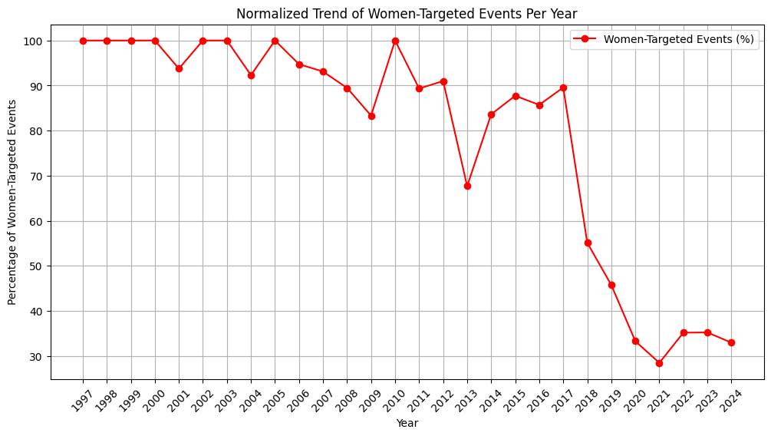
What trends can be observed in the percentage of women-targeted events over time, and what factors might explain the significant decline after 2017?
Key Insights from the Plot:
1997-2010: High and Stable Trend
Women-targeted events remained consistently near 100%, indicating a strong focus on gender-based targeting during this period.
2011-2017: Gradual Decline with Fluctuations
The percentage started to decrease, showing variations, which could be due to shifts in conflict dynamics, awareness campaigns, or changes in reporting methods.
2018-Present: Sharp Drop & Stabilization
A major decline after 2017, reaching around 30% by 2021-2024. Possible reasons include:
More indiscriminate attacks rather than gender-specific violence.
Improved policies and protections reducing women-targeted incidents.
Changes in classification or reporting methods.
2021-2024: New Normal at Lower Levels
The percentage has stabilized around 30-35%, suggesting a permanent shift in targeting patterns.

Slide 6
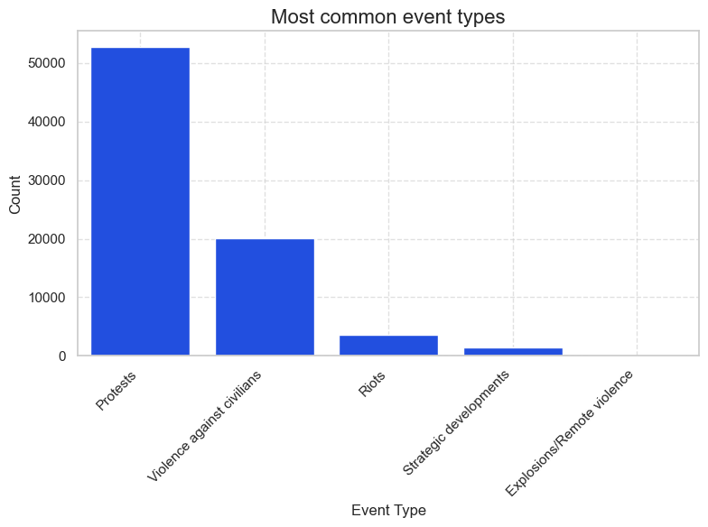
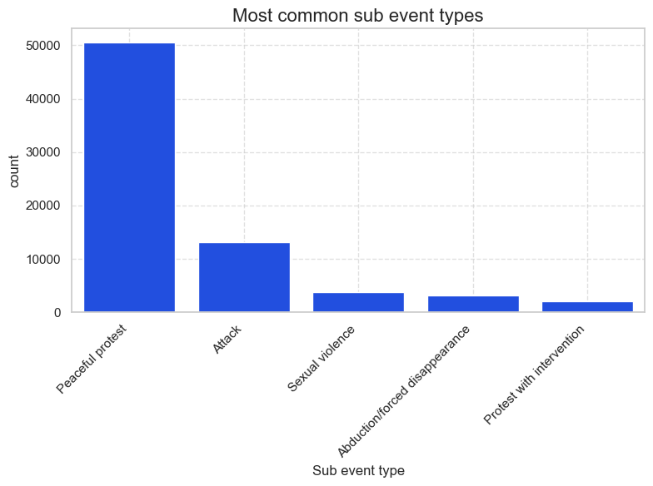
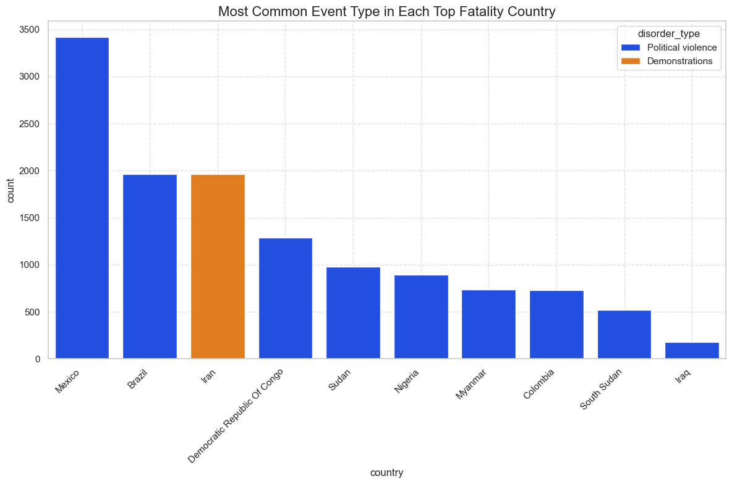
What are the most common types of PVTW events, and how does their frequency compare across the different categories?
The bar chart categorizes PVTW events into Protests, Violence against civilians, Riots, Strategic developments, and Explosions/Remote violence.
Some categories have disproportionately high occurrences.
💡 Key Insights:
Most Common Event Type:
Violence against civilians is the leading category, suggesting that political actors and extremist groups frequently target female politicians and activists.
Patterns of Violence:
Protests and riots also have notable participation, indicating that women engaging in political demonstrations face significant threats.
Implications:
Women in politics are vulnerable not only in formal political settings but also during activism and protests, highlighting the need for protective measures.

Slide 7
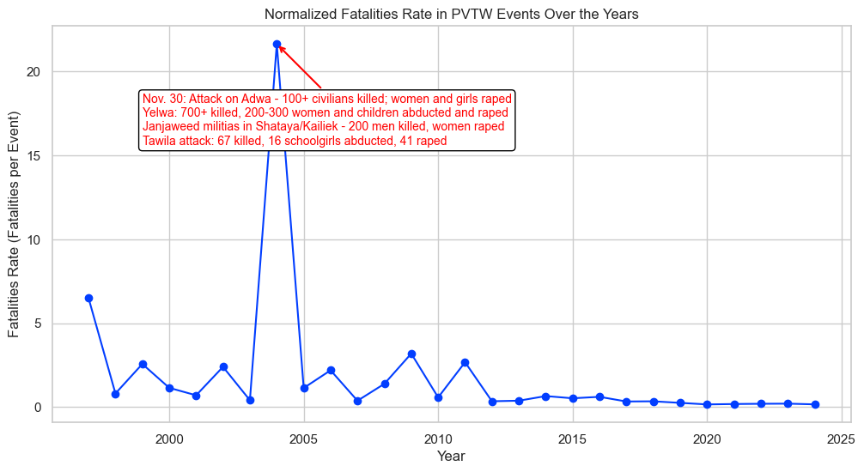
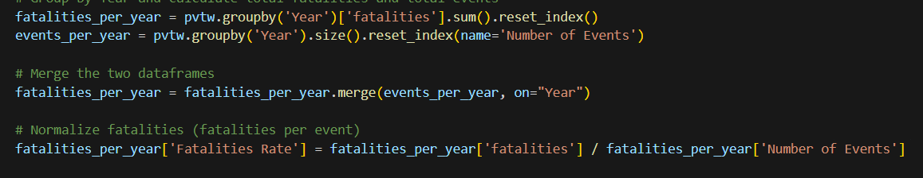
How has the normalized fatality rate (fatalities per event) evolved over time in political violence targeting women, and what trends or spikes can be observed across the years?
The graph presents fatality rates per event across different time periods.
Some periods show significantly higher fatalities, while others remain relatively stable.
💡 Key Insights:
Fatality Peaks:
Fatality spikes align with periods of political unrest, suggesting a direct link between instability and gender-targeted political violence.
Implications:
Women in politics in these regions face life-threatening risks, emphasizing the urgent need for policy interventions and security measures.

Slide 8
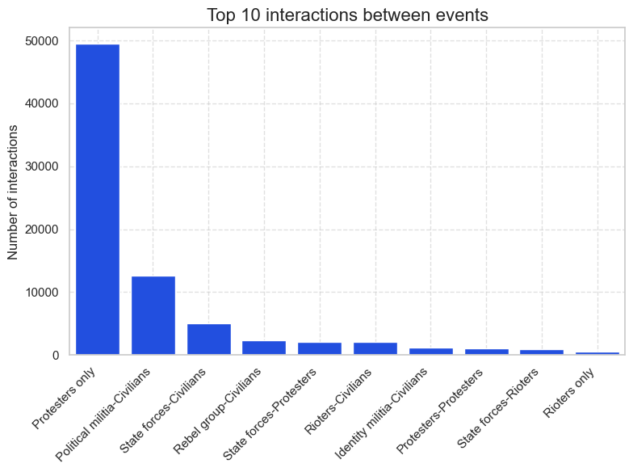
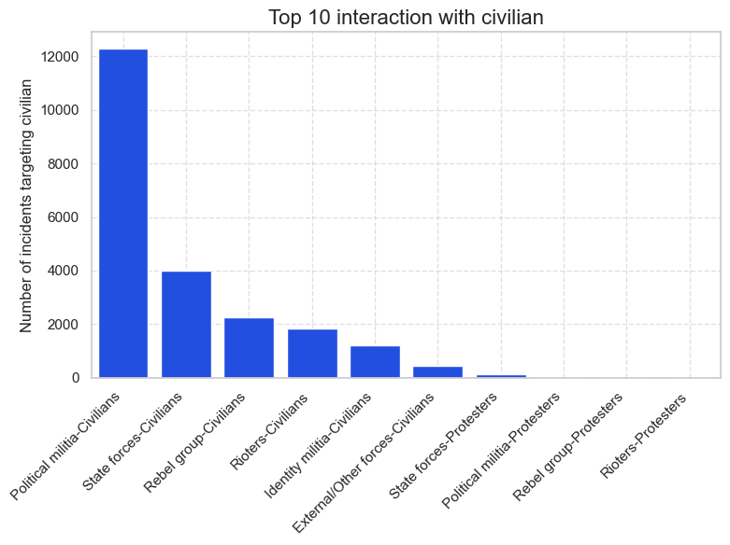
What are the most frequent interactions between different types of events in and the most frequent types of interactions involving civilians in political violence
The graph visualizes the most common interactions in political violence, focusing on who the perpetrators and victims are.
State forces, opposition groups, and extremist organizations are the primary actors.
💡 Key Insights:
Perpetrators:
State actors and extremist groups frequently target women in politics, implying institutionalized or organized suppression.
Victim Profiles:
Women politicians and activists appear most frequently in the dataset, suggesting that visibility in politics increases the risk of being targeted.
Implications:
Political violence targeting women is not random but systematically linked to political power struggles.

Slide 9
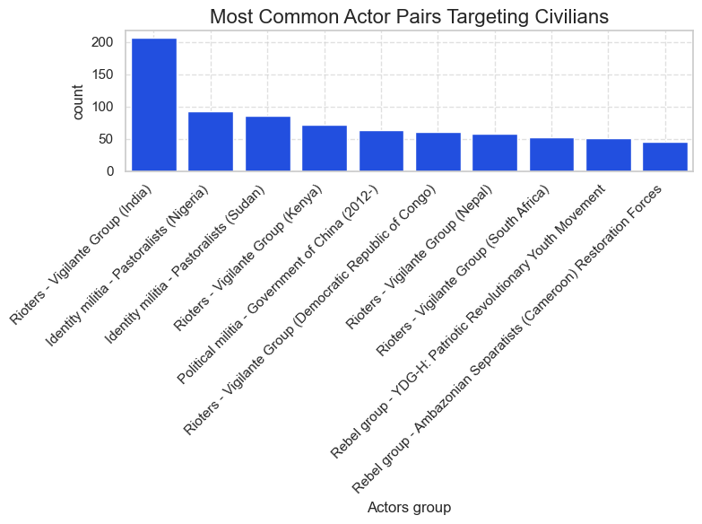
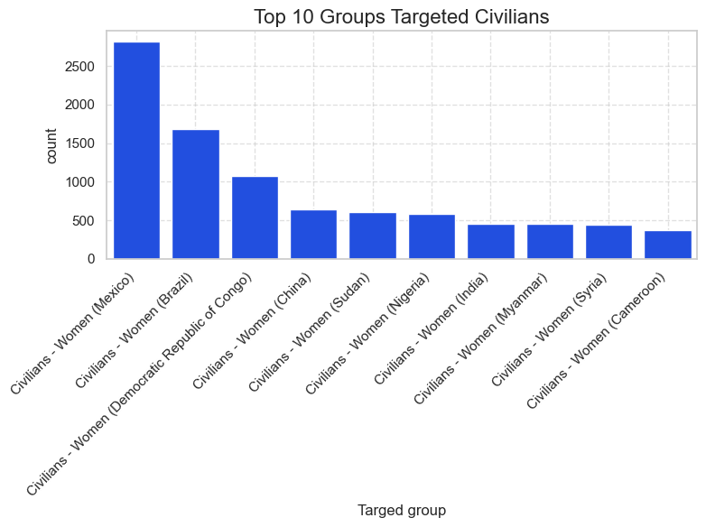
Which actor pairs are most frequently involved in targeting civilians and Which groups of women are most commonly targeted in political violence, and how do these interactions shape the landscape of political violence?
The graph categorizes perpetrators of PVTW events into State forces, Non-state armed groups, and Political extremists.
💡 Key Insights:
State vs. Non-state Actors:
In some regions, state forces are among the primary perpetrators, indicating government-backed suppression of women in politics.
Non-state armed groups and political extremists also contribute significantly, particularly in conflict zones.
Implications:
The presence of state actors in gender-based political violence indicates potential policy failures or complicity in suppressing women’s political participation.

Slide 10
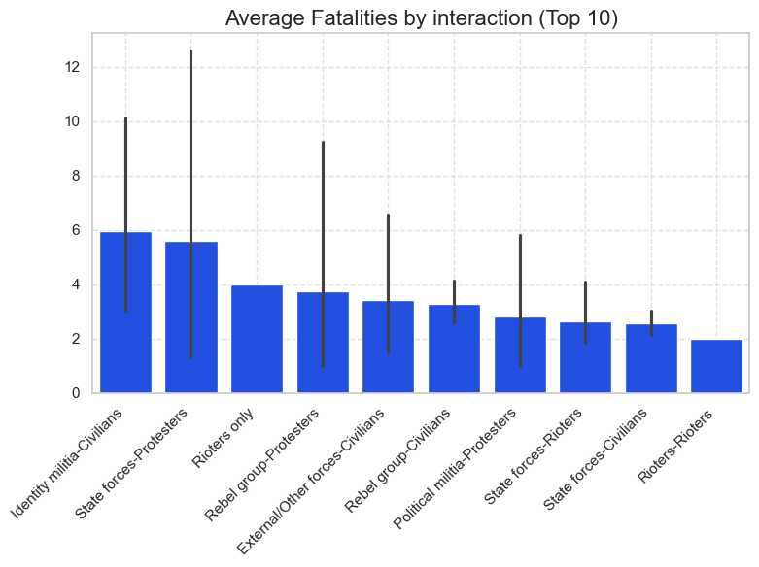
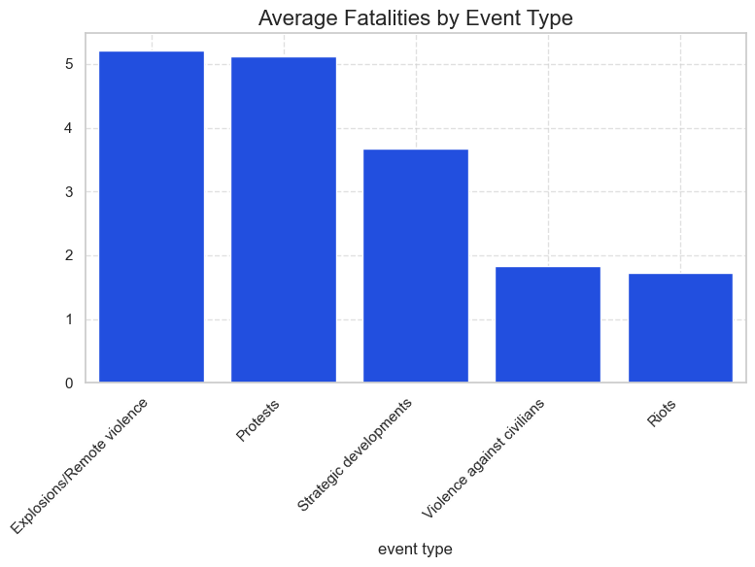
Which types of interactions result in the highest number of fatalities, and how do these interactions differ in terms of severity and impact on civilian populations?
It highlights which actor-actor interactions result in the highest number of deaths rate.
A clear distinction is observed between state-involved conflicts, non-state group conflicts, and attacks targeting civilians.
Highest Fatality Interactions:
State Forces vs. Non-State Armed Groups result in the most fatalities, suggesting large-scale, organized conflicts.
Non-State Armed Groups vs. Civilians also exhibit high fatality rates, indicating significant targeting of civilians in political violence.
Severity and Impact on Civilians:
State Forces vs. Protesters have a lower fatality rate but can still escalate into mass violence depending on the country’s political stability.
Extremist Groups vs. Civilians tend to be among the deadliest interactions, as these events are often premeditated and intended to create fear.
🔎 Implications:
Targeted violence against civilians suggests a need for better protective policies.
High fatality rates in state vs. non-state conflicts indicate that armed conflicts continue to be a major contributor to political violence fatalities.

Slide 11
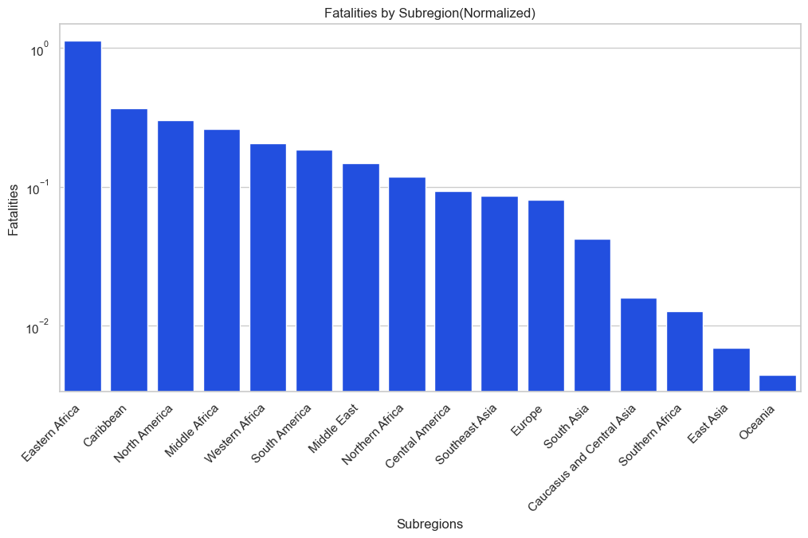
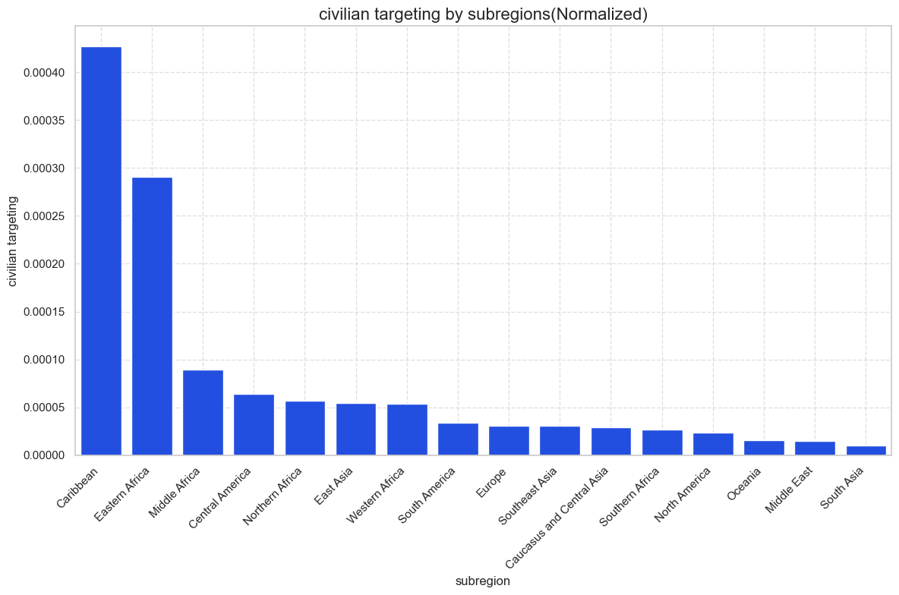
What are the most common region of showing fatalities rate different types of events in and the most frequent types of interactions involving civilians in political violence
For some regions, High fatalities do not always correlate with high civilian targeting. For example, North America has high fatalities but relatively lower civilian targeting.
Caribbean and Eastern Africa experience a high rate of civilian targeting relative to total incidents.
The Middle East, despite being conflict-prone, has a lower civilian targeting rate in the normalized data.
Oceania has the lowest fatality rate, which suggests relatively lower conflict intensity.
Key Insights

Slide 12
Selecting Statistical Test
The dataset we are analyzing focuses on the number of PVTW events and fatalities across different years, event types, and countries etc. Since both PVTW events and fatalities are discrete count-based data, they do not follow a normal distribution. This means that using simple linear regression could lead to misleading results.
Data Insights:
Mean Fatalities: 62
Variance of Fatalities: 9774
Data Characteristics:
Fatalities are discrete count data → Not normally distributed.
Overdispersion detected (variance >> mean).
Method Selection:
Spearman’s Rank Correlation (for non-normal distributions).
Negative Binomial GLM (to handle overdispersion in count-based data).
Mann-Whitney U test(for two groups which have skewed data)
Why Not Linear Regression?
Assumes normality, which PVTW events do not follow.
Conclusion:
We have chosen Spearman's rank correlation and Mann-Whitney U test for non-parametric analysis, ensuring robust results for skewed data.
We will model fatalities using Negative Binomial GLM, which allows for a more appropriate non-linear approach compared to traditional OLS regression.

Slide 13
Statistical Test Findings
Test | Variable | Result | Findings
Spearman's rank correlation | Average Women Representation VS Total Fatalities | Correlation : 0.38, P-value: 6.142e-11 | There is a weak positive correlation between women representation and fatalities, with a very significant relationship (p-value < 0.05).
Mann-Whitney U test | Total fatalities by non-transitional period Vs Total fatalities by transitional period | Statistics 16935.5, P-value: 6.14e-11 | A significant difference in fatalities between non-transitional and transitional period, with a very low p-value indicating the difference is unlikely due to chance.
Spearman's rank correlation | Total Fatality by transitional period | Correlation :0.22 P-value: 0.004 | There is a low positive correlation between transitional period and fatalities with a highly significant p-value.
Spearman's rank correlation | Total Fatality by non-transitional period | Correlation : 0.65 P-value: 1.16e-39 | Strong positive correlation between non transitional period and fatalities, with a highly significant p-value.

Slide 14
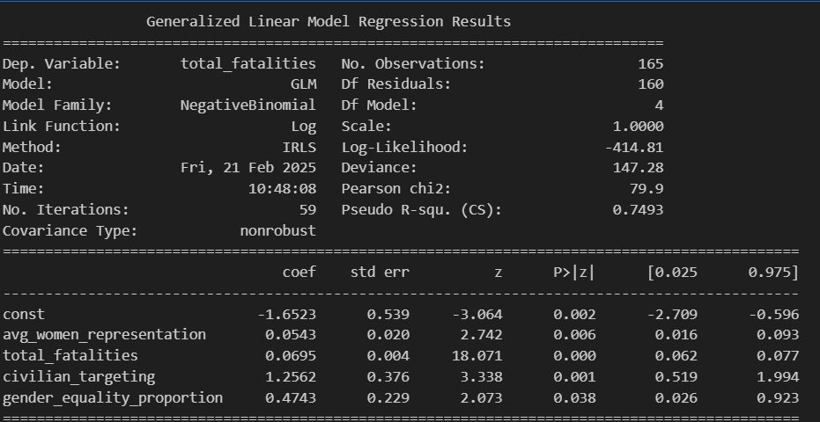
GLM Negative Binomial Model Result for transitional period
Coefficient | Value | P-Value
Constant | -1.65 | 0.002
Average Women Representation | 0.054 | 0.006
Total Fatalities | 0.0695 | 0
Civilian Targeting | 1.256 | 0.001
Gender Equality Proportion | 0.47 | 0.038
Significant Variables: Women Representation: There is a positive and significant relationship between women representation in parliament and fatalities (coef=0.0543, p=0.006), suggesting that higher women representation could be linked to an increase in attacks on political figures.
Total Fatalities: The coefficient for total fatalities (coef=0.0695, p=0.000) is highly significant, indicating that an increase in fatalities is associated with greater impact from the other variables.
Civilian Targeting: Civilian targeting is highly significant (coef=1.2562, p=0.001), suggesting that in areas with higher civilian targeting, there is a stronger likelihood of fatalities.
Gender Equality Proportion: The gender equality proportion has a significant positive relationship (coef=0.4743, p=0.038), indicating that more gender equality may be associated with more attacks.

Slide 15
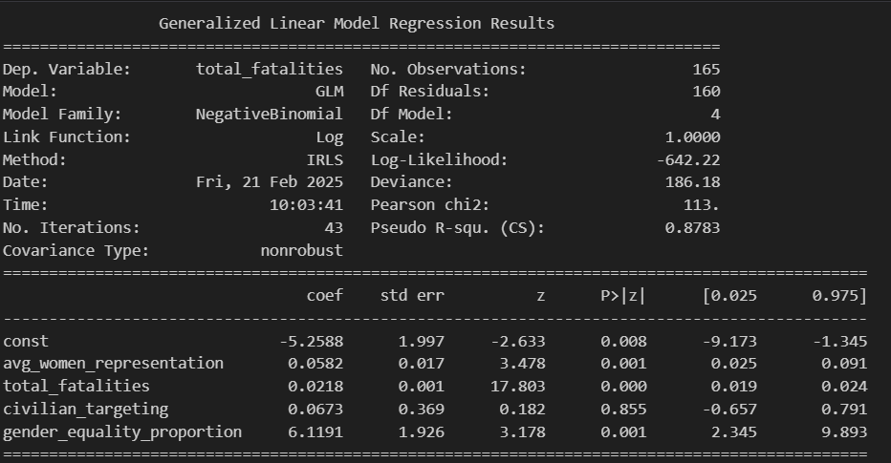
GLM Negative Binomial Model Result for Non-Transitional Period
Coefficient | Value | P-Value
Constant | -5.25 | 0.008
Average Women Representation | 0.058 | 0.001
Total Fatalities | 0.021 | 0
Civilian Targeting | 0.067 | 0.855
Gender Equality Proportion | 6.1191 | 0.01
Women Representation: The relationship between women representation and fatalities remains significant (coef=0.0582, p=0.001), though with a smaller effect compared to transitional period. This suggests that the relationship holds even when attacks are less frequent.
Total Fatalities: As in transitional period, fatalities show a significant effect (coef=0.0218, p=0.000), but with a lower magnitude, indicating smaller changes in fatalities compared to transitional period.
Civilian Targeting: The civilian targeting coefficient is not significant (coef=0.0673, p=0.855), indicating that in areas with fewer attacks, civilian targeting does not show a strong relationship with fatalities.
Gender Equality Proportion: The coefficient for gender equality proportion is highly significant (coef=6.1191, p=0.001), suggesting a strong relationship between gender equality and fatalities in regions with fewer attacks. This contrasts with transitional period, where the effect of gender equality was less pronounced.

Slide 16
Summary & Conclusion
Based on the statistical tests, we reject the null hypothesis (H₀) and accept the alternative hypothesis (H₁). The analysis indicates that higher women’s representation is associated with an increase in political violence (PVTW events) and fatalities. However, the severity and nature of these fatalities vary depending on the country’s transitional status.
Interpretation & Possible Explanations
Why does higher women’s representation lead to more fatalities?
Backlash Effect: As more women participate in politics, traditional power structures may feel threatened, leading to resistance and targeted violence. In transitional countries, this backlash could be more pronounced, especially when social and political systems are adjusting.
Visibility & Threat Perception: With greater representation, women in political roles attract more media and opposition attention, which may increase their vulnerability to targeted attacks, especially in regions with higher instability.
Structural Weaknesses: In some transitional settings, higher representation does not always translate into real political power or protection, leaving women in vulnerable positions without sufficient institutional safeguards.
Why does non-transitional status reduce fatalities?
Institutional Stability: Countries in transition often implement peace processes, conflict resolution mechanisms, and international monitoring, which help reduce violence levels. It is observed in the non-transitional model suggests that stable or less violent environments may allow for better control over political violence.
Political Negotiations: NonTransitional governments might have agreements or frameworks in place to prevent excessive violence. These agreements could help mitigate the impact of political violence, unlike in transitional countries where instability persists.
Law Enforcement & Human Rights Measures: Non-Transitional periods frequently involve democratic reforms, greater international scrutiny, and human rights measures that discourage the use of violence as a political tool.

Slide 17
Possible Confounding Effect:
Transitional status could be affecting the relationship between women’s representation ,fatalities and PVTW events.
In transitional period, increasing transitional status might introduce political instability, leading to more violence.
In non-transitional period, once the political system starts stabilizing, violence may naturally decrease over time despite higher women’s representation.
This suggests transitional status moderates or interacts with the effect of women’s representation on fatalities rather than being a purely direct cause.
However, transitional status appears to be a potential confounding factor:
In both transitional period, more women in parliament is linked to higher fatalities.
Transitional period experience even higher fatalities overall, suggesting that political instability plays a role.
The relationship between transitional status and fatalities behaves differently in both transitional period, indicating a complex interaction.
Women’s increasing political participation correlates with higher PVTW-related violence, but the effect is likely influenced by the country’s transitional status.
Transitional status could be a confounder, affecting both women’s representation and fatalities.

Slide 18
Final Conclusion
Women’s representation is positively correlated with an increase in PVTW events and fatalities.
Transitional status significantly related to fatalities, suggesting it is a potential confounding factor in political violence analysis.
Women’s representation does not automatically lead to safer political environments. Instead, it is intertwined with political stability and societal attitudes toward women in leadership.
Transitional Period Shows severity of PVTW events and fatalities:
In transitional period, increasing political transitions may intensify violence.
In non-transitional period, instability reduces fatalities over time as the system evolves.
Further Research Needed:
Investigating regional variations and specific political events can help refine these insights.
Examining additional factors such as media influence, policy changes, and social attitudes can provide a more comprehensive understanding.
Future research should control for additional factors like political stability, law enforcement policies, and external interventions

Slide 19
Thank you

Slide 20
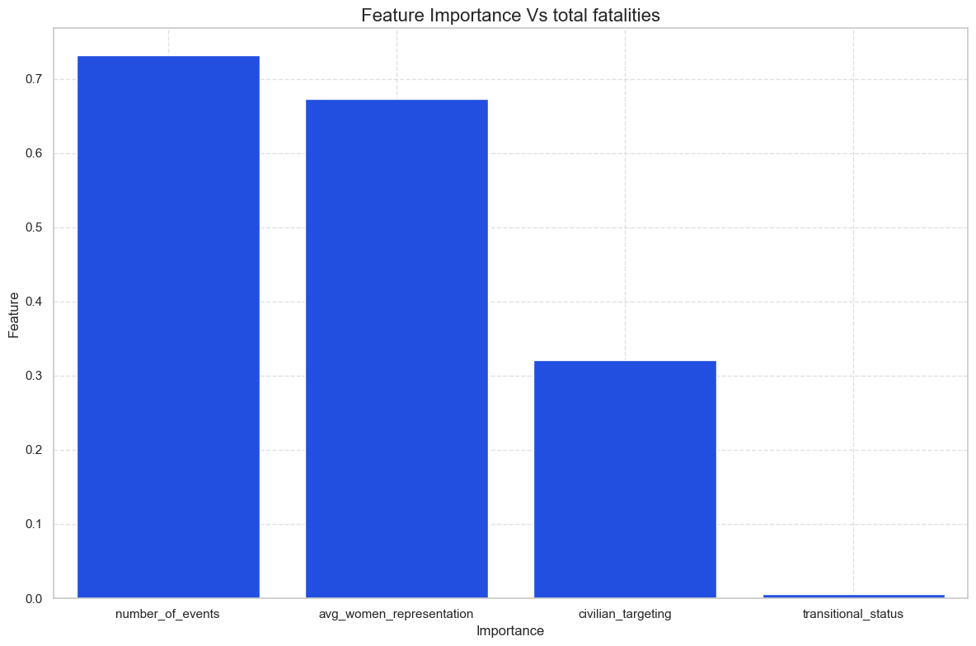
Which actor pairs are most frequently involved in targeting civilians and Which groups of women are most commonly targeted in political violence, and how do these interactions shape the landscape of political violence?
The graph presents the relative importance of different features (e.g., Women’s Representation, Civilian Targeting, Transitional Status) in predicting fatalities.
💡 Key Insights:
Top Predictors:
Women’s representation (67.3%) is the strongest predictor, meaning that in countries where more women participate in politics, there is a higher likelihood of political violence targeting them.
Civilian targeting (32.1%) also plays a major role, emphasizing the broader issue of civilian vulnerability.
Transitional status (0.5%) has minimal impact, suggesting that while political transition may increase instability, its effect on PVTW events is not as strong as expected.
Implications:
Countries with higher women’s representation need additional safeguards to protect female politicians from targeted violence.
Model Performance
R-squared: 0.12: This indicates that only 12% of the variance in total fatalities is explained by the model. This could suggest that there are other factors influencing fatalities that the model isn't capturing (possibly the need for more features or complex interactions).
RMSE: 107.23: This is the average error between predicted and actual fatalities. The model's RMSE is relatively large, which further suggests that improving the model or adding more features might be needed.
Interpretation
Key Insights:
Women's representation is by far the most important factor in predicting total fatalities. This reinforces the idea that increasing women’s representation has a strong relationship with political violence.
Civilian targeting also plays a significant role, which might indicate that the broader scope of violence (beyond just targeting women) impacts the fatalities.
Transitional status has a minimal effect after considering the other factors, despite showing some correlation earlier.
Room for Improvement:
The R-squared is relatively low, suggesting that there might be other important features missing, or a more complex model is needed (such as gradient boosting, XGBoost, or deep learning approaches).

